Slide 1








“Streaming Platforms”
A Data Analytics Project
Part 1: Data Analysis
By: Zachary Mason
Nic Mallet
Mauricio Gil

Slide 2




Contents
1
What We Wanted to Know
2
The Emmy Nominees Are...
3
Who Has the Time?!
4
We Do It For the Kids
What a Drama Queen
5
HBO: The Home for Movies
6
The More Seasons the Better?
7

Slide 3

What We Wanted to Know
What are the top 20 shows and movies on each SS (streaming service)
Which SS had a greater variety of shows based on release year (50’s, 70’s, 90’s, etc.)
What is the average rating on each platform (G, PG, T, R)
Comparing genres counts for each SS
What is the average IMDb score for each SS
Does the number of seasons per show influence its IMDb score

Slide 4


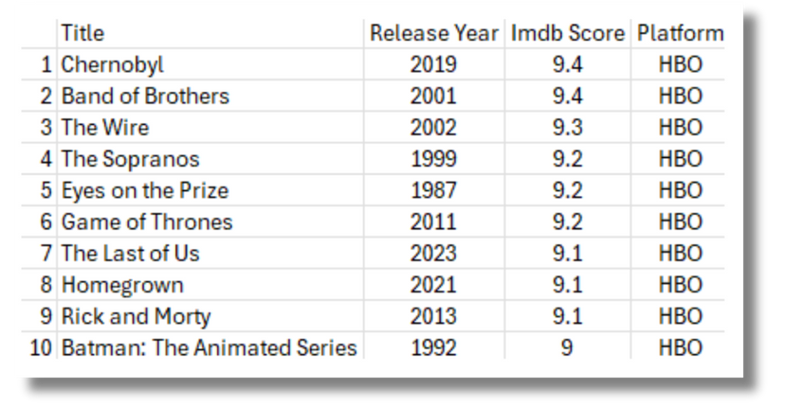
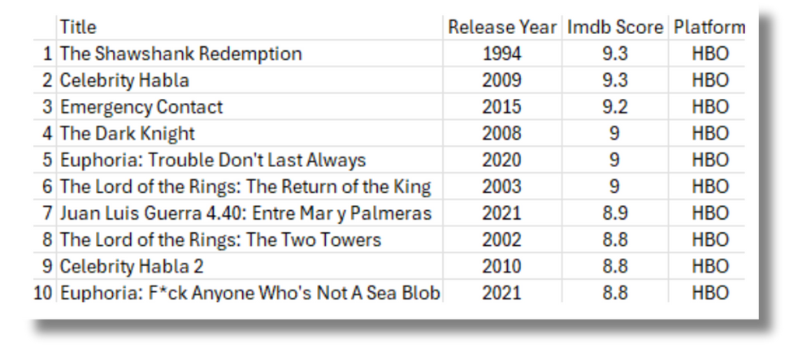
The Emmy Nominees are...
Shows
Movies
Notes:
We wanted to see what the top rated movies/shows. In this slide, you can see the top 10 movies and shows on the HBO platform. First we collected shows and movies using the same platform and then cleaned the data, sort_value function was used to group the data. Then we were able to visualize the top 10 movies and shows.

Slide 5
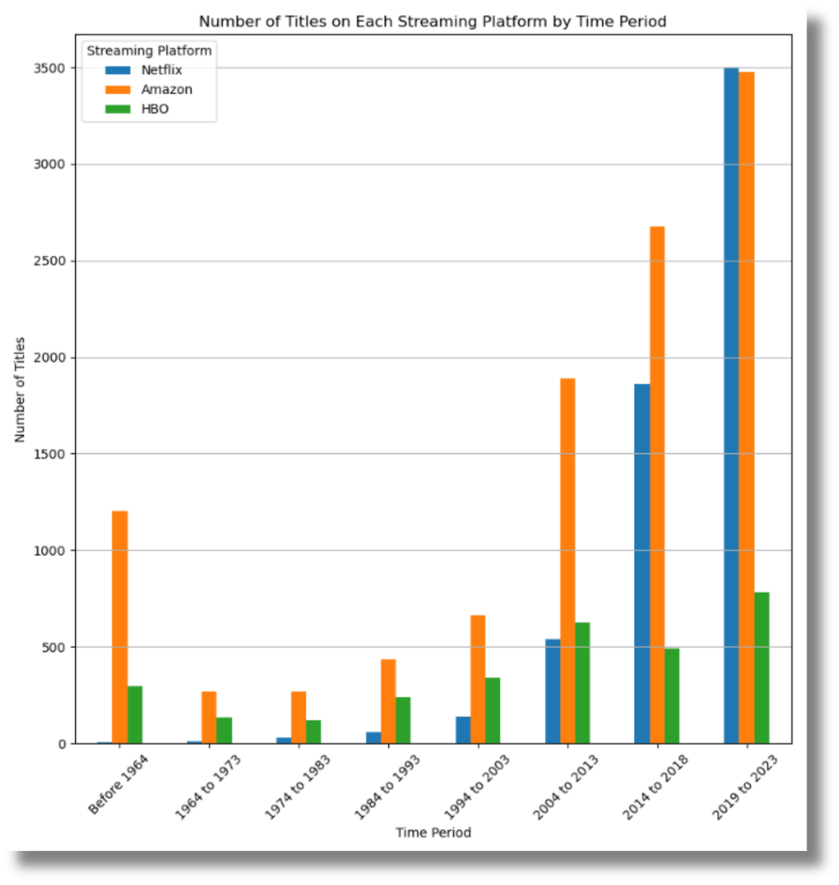

Who Has the Time?
Which platform offers content for all ages?
Notes:
What streaming platform offers the widest variety of movies and shows based on release year? From the graph we can see that Amazon has tons of shows to choose from from various decades, increasing its ability to capture a larger audience.

Slide 6




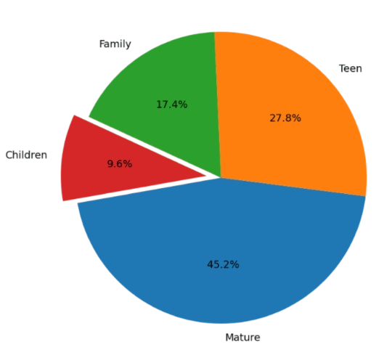
We Do It for the Kids
Distribution of Ratings on Netflix
Who has the most family friendly platform?
Children ratings include : TV-Y7 ,TV-Y, TV-G, TV-Y7-FV
Notes:
One thing we looked at was the makeup of each platform’s titles based on rating. For example, you have a family with young children, What platform offers the most family friendly television and movies? It’s important when you have a family to supply content for everyone so we wanted to know who is providing shows for everyone. After categorizing the the various ratings given to shows we narrowed our data down to four data labels; Children, Family, Teen, Mature. If you had a younger family Netflix appears to be the best platform for kids. Not pictured here is the HBO graph which appears to be the best for a more mature audience with ~48% mature ratings.

Slide 7


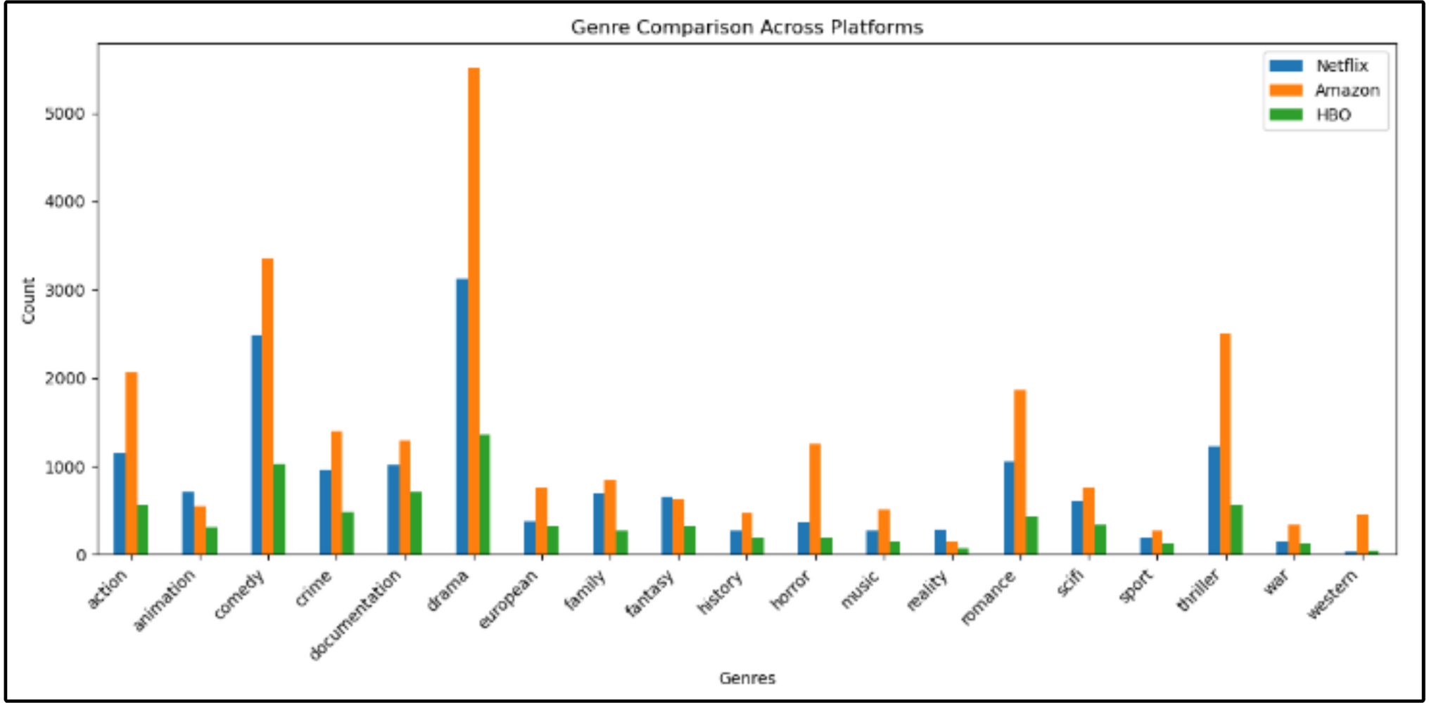
What a Drama Queen
Notes:
What genres of tv shows or movies interest you the most, what do you not enjoy?

Slide 8



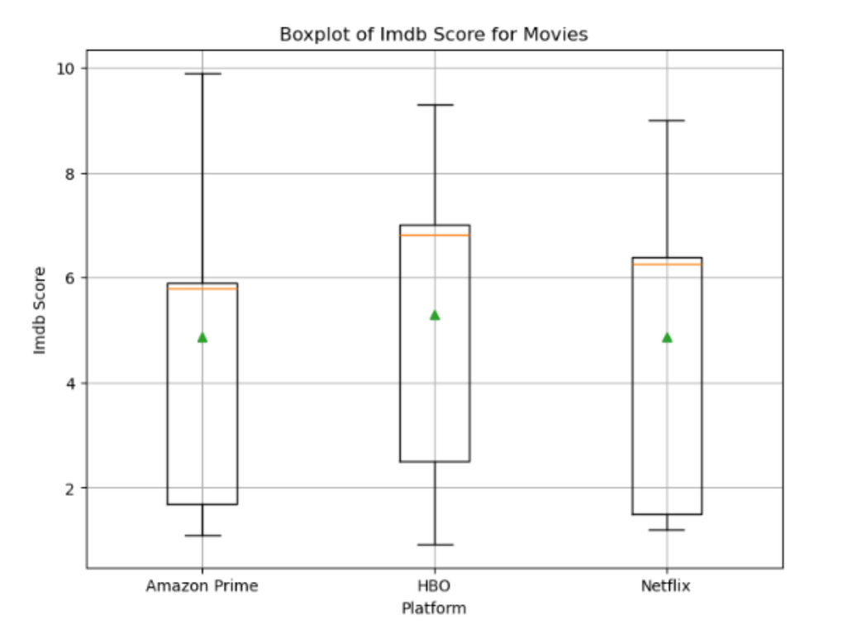
HBO: The Home for Movies
What is the average IMDb Score for each platform?
Notes:
We wanted to understand which platform provided the highest quality of content for movies. We began by collecting and analyzing all scores for all movies found on the three platforms. We then created an aggregate summary of the data, computing the mean median mode std and var which allowed us to make this beautiful box plot! The orange line represents the median of the data while the green dot represents the mean. The box itself houses a majority of the data with the ends of each being the extremes. As you can see HBO appears to have a larger amount of highly rated movies and a higher overall average. If you value movies HBO is the place as you’re likely to find a better movie there.

Slide 9

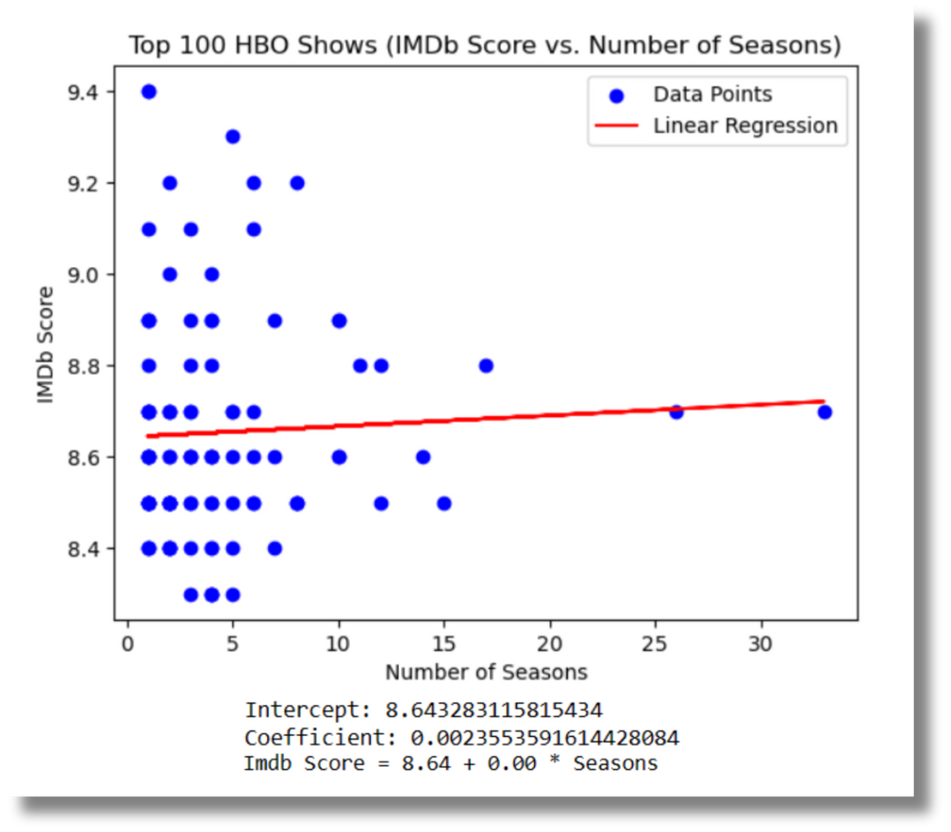
The More Seasons the Better?
Does the number of seasons impact the shows IMDb Score?
How have limited series impacted television?
Notes:
Here we wanted to see if the number of seasons for a show could be used to predict their IMDb scores. When we compared the IMDb Scores of shows with their amount of seasons it appears there is not a significant relationship with the two variables. This is most apparent by the funnel shape seen in the data. There is a cluster between 1-5 seasons, this may be part of the recent likability of “limited series” shows.

Slide 10



The End

Slide 11
Questions?

